Slide 1
A Novel, Low-latency Algorithm for Multiple Group-By Query Optimization
Presentation by
Daniel Kane & Ethan Letourneau

Slide 2
Paper Details
Duy-Hung Phan & Pietro Michiardi from the EURECOM Institute
IEEE’s ICDE 2016
Tackles optimization of data summarizations, for which the Group By operator is the building block.

Slide 3
Problem
No prior solution on efficiently computing a set of multiple Group By queries scales well with a large number of attributes and/or a large number of queries.
So, the algorithm of this paper:
Scales well with both of these considerations
Finds equally optimal or better execution plans than most other state-of-the-art algorithms
Does so in several orders of magnitude less time than previous works

Slide 4

Definitions and assumptions
Input data is a table T with m number of attributes. Let S = { s1, s2, …, sn } be the set of groupings needing to be computed from n group-by queries; each query Qi will be of the following form:

Slide 5
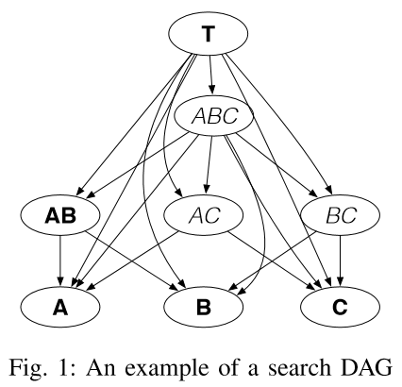
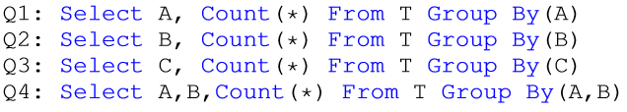
Definitions and assumptions
Search DAG, A directed acyclic graph G = (V, E) s.t:
Each node v ∈ V is a grouping, making the set V all possible combinations of groupings
Each edge e = (u, v) ∈ E from node u to node v indicates the grouping v can be computed from grouping u
Each edge e also has an associated cost of computing v from the grouping u, which can be a sorting cost or a scanning cost.
Figure 1 describes a Search DAG for input table T=(A,B,C) and the following Group By queries:

Slide 6
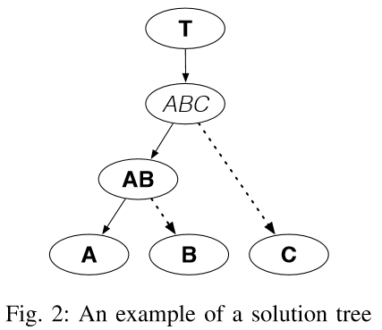
Definitions and assumptions
Solution Tree, a subtree of a Search DAG G s.t.:
Each terminal node is covered
Each edge has only one cost type associated with it
Each node has at most one outgoing scan-cost edge
Computing the optimal Solution Tree having the minimal total execution cost for a set of Group By queries is the objective of this paper.
Figure 2 shows an optimal Solution Tree for the set of Group By queries from the previous slide.

Slide 7

TOP-Down Splitting Algorithm
The Top-Down Splitting Algorithm consists of 5 algorithms (the 5th and final shown below) that execute the following general plan:
First builds a preliminary “naïve” solution tree consisting of only root node and terminal nodes
Then repeatedly optimizes the tree, adding nodes in to reduce the total execution cost.
We only consider nodes in this second step that evenly split a nodes children into k subsets, transforming it into a k-way tree.

Slide 8
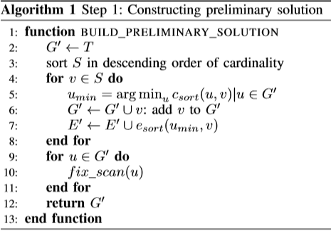
Preliminary Tree Construction
The initial tree we input into the TDS Algorithm contains only the root node and terminal nodes.
Sort nodes on descending order of their cardinalities.
Traverse through each node n, adding each to initial tree G’ by finding node already in G’ that has lowest sort cost for n, and making n a child of that node.
Once constructed, iterate through all nodes in G’ and “fix” the costs. We find child node for each node n for which changing the cost from sort to scan would result in the largest decrease and change it.

Slide 9
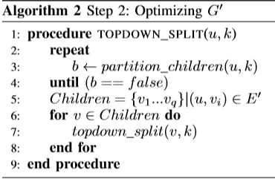
Top-DOWN SPLIT
u = Root Node, k = Maximum # of Subsets.
Repeatedly calls the Partition Children function (explained in next slide) which basically splits the children nodes of u into at most k subsets.
Partition Children returns true if the children of u were able to be optimized, false if it cannot be further optimized.
The top-down split is then recursively called for each child node of u.

Slide 10
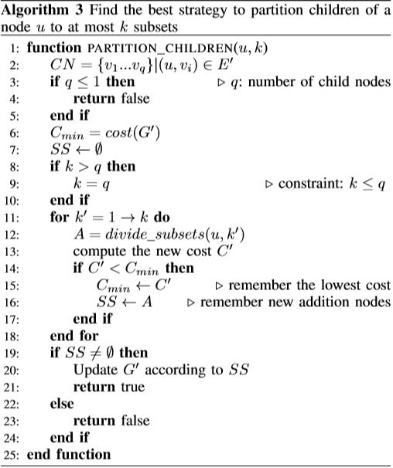
Partition Children
u = A Node, k = Maximum # of Subsets.
Splits the children nodes of u into at most k subsets, each represented by additional node that is the union of all nodes in the SS.
Sees if computing children nodes from a subset instead of from u will reduce total cost.
The for-loop calls Divide Subsets for each value from one to k, so that we can see which of every possible partition strategy will give lowest total cost.
The once the best subsets are found, make them the children of u, and the previous children the children nodes of the appropriate subset(s).

Slide 11
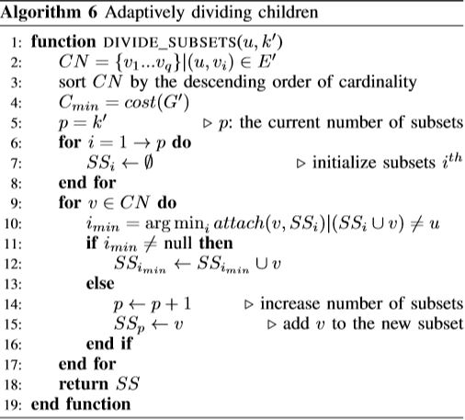


Divide Subsets
u = A Node, k’ = Maximum # of Subsets.
Sorts each of the child nodes of u by cardinality, initializes k’ number of empty subsets.
For each child node of u being v, search through each subset to see which would give the least increase in cost when attaching v to the subset, then union v with the least cost SS.
If there are no remaining subsets for v to attach to because doing so would make them equal to u, we add an additional SS to the list and put v there.

Slide 12
Experimentation
Authors evaluated against other algorithms for multi-Group By on the following aspects:
Optimization Latency = time taken to return optimal solution tree
Solution Cost = total cost of the resulting optimal solution tree
Runtime = time to complete a set of Group By’s using the solution tree
Used dataset TPC-H’s largest table called “Lineitem” (~10 million rows, 16 attributes)
Tested by issuing all possible two-attribute Group By’s on the table
Tested against naïve solution, Bottom-Up Merge and Partial Lattice Cube.

Slide 13

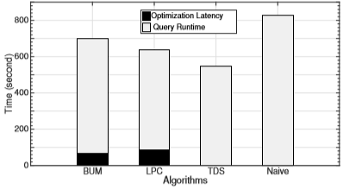
Results
As we can see, Top-Down Split outperforms all other implementations on the aforementioned Multiple Group By.
Also notice the Optimization Latency is near-zero percent of the total runtime for TDS, as opposed to BUM (9.45%) and LPC (13.63%).

Slide 14
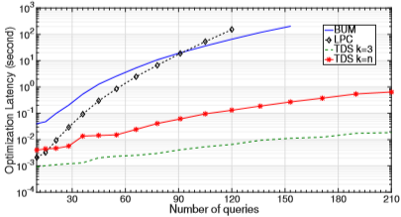
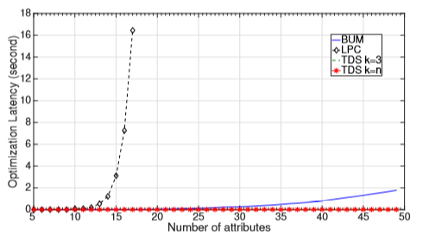
Additional Figures

